Slide 1
TLS Visibility
CS 361S
Spring 2020
Seth James Nielson

Slide 2

TLS Visibility
TLS is designed to provide END-TO-END “security”
MITM should NOT be able to read/modify/forge data
TLS Visibility “breaks” this for “authorized” purposes

Slide 3
b"\x12\x0e\x7f6(g\xda\x86_\xe7\xf4\xcb\xe8\x92\xddJ\x17\xb0\x04'\xa0\xb0\xb8\x9b\xed\x84\x91O&W3'"
b"\x12\x0e\x7f6(g\xda\x86_\xe7\xf4\xcb\xe8\x92\xddJ\x17\xb0\x04'\xa0\xb0\xb8\x9b\xed\x84\x91O&W3'"
MITM
WEB BROWSER
WEB SERVER
TLS VISIBILITY
DECRYPT: GET / HTTP/1.1
DECRYPT: HTTP/1.1 200 OK

Slide 4
TLS 1.2 Handshake
Goal
Agree on a cipher suite for encryption, authentication, etc.
Goal
Identify the server (and optionally the client)
Goal
Create session keys for bi-directional communication

Slide 5
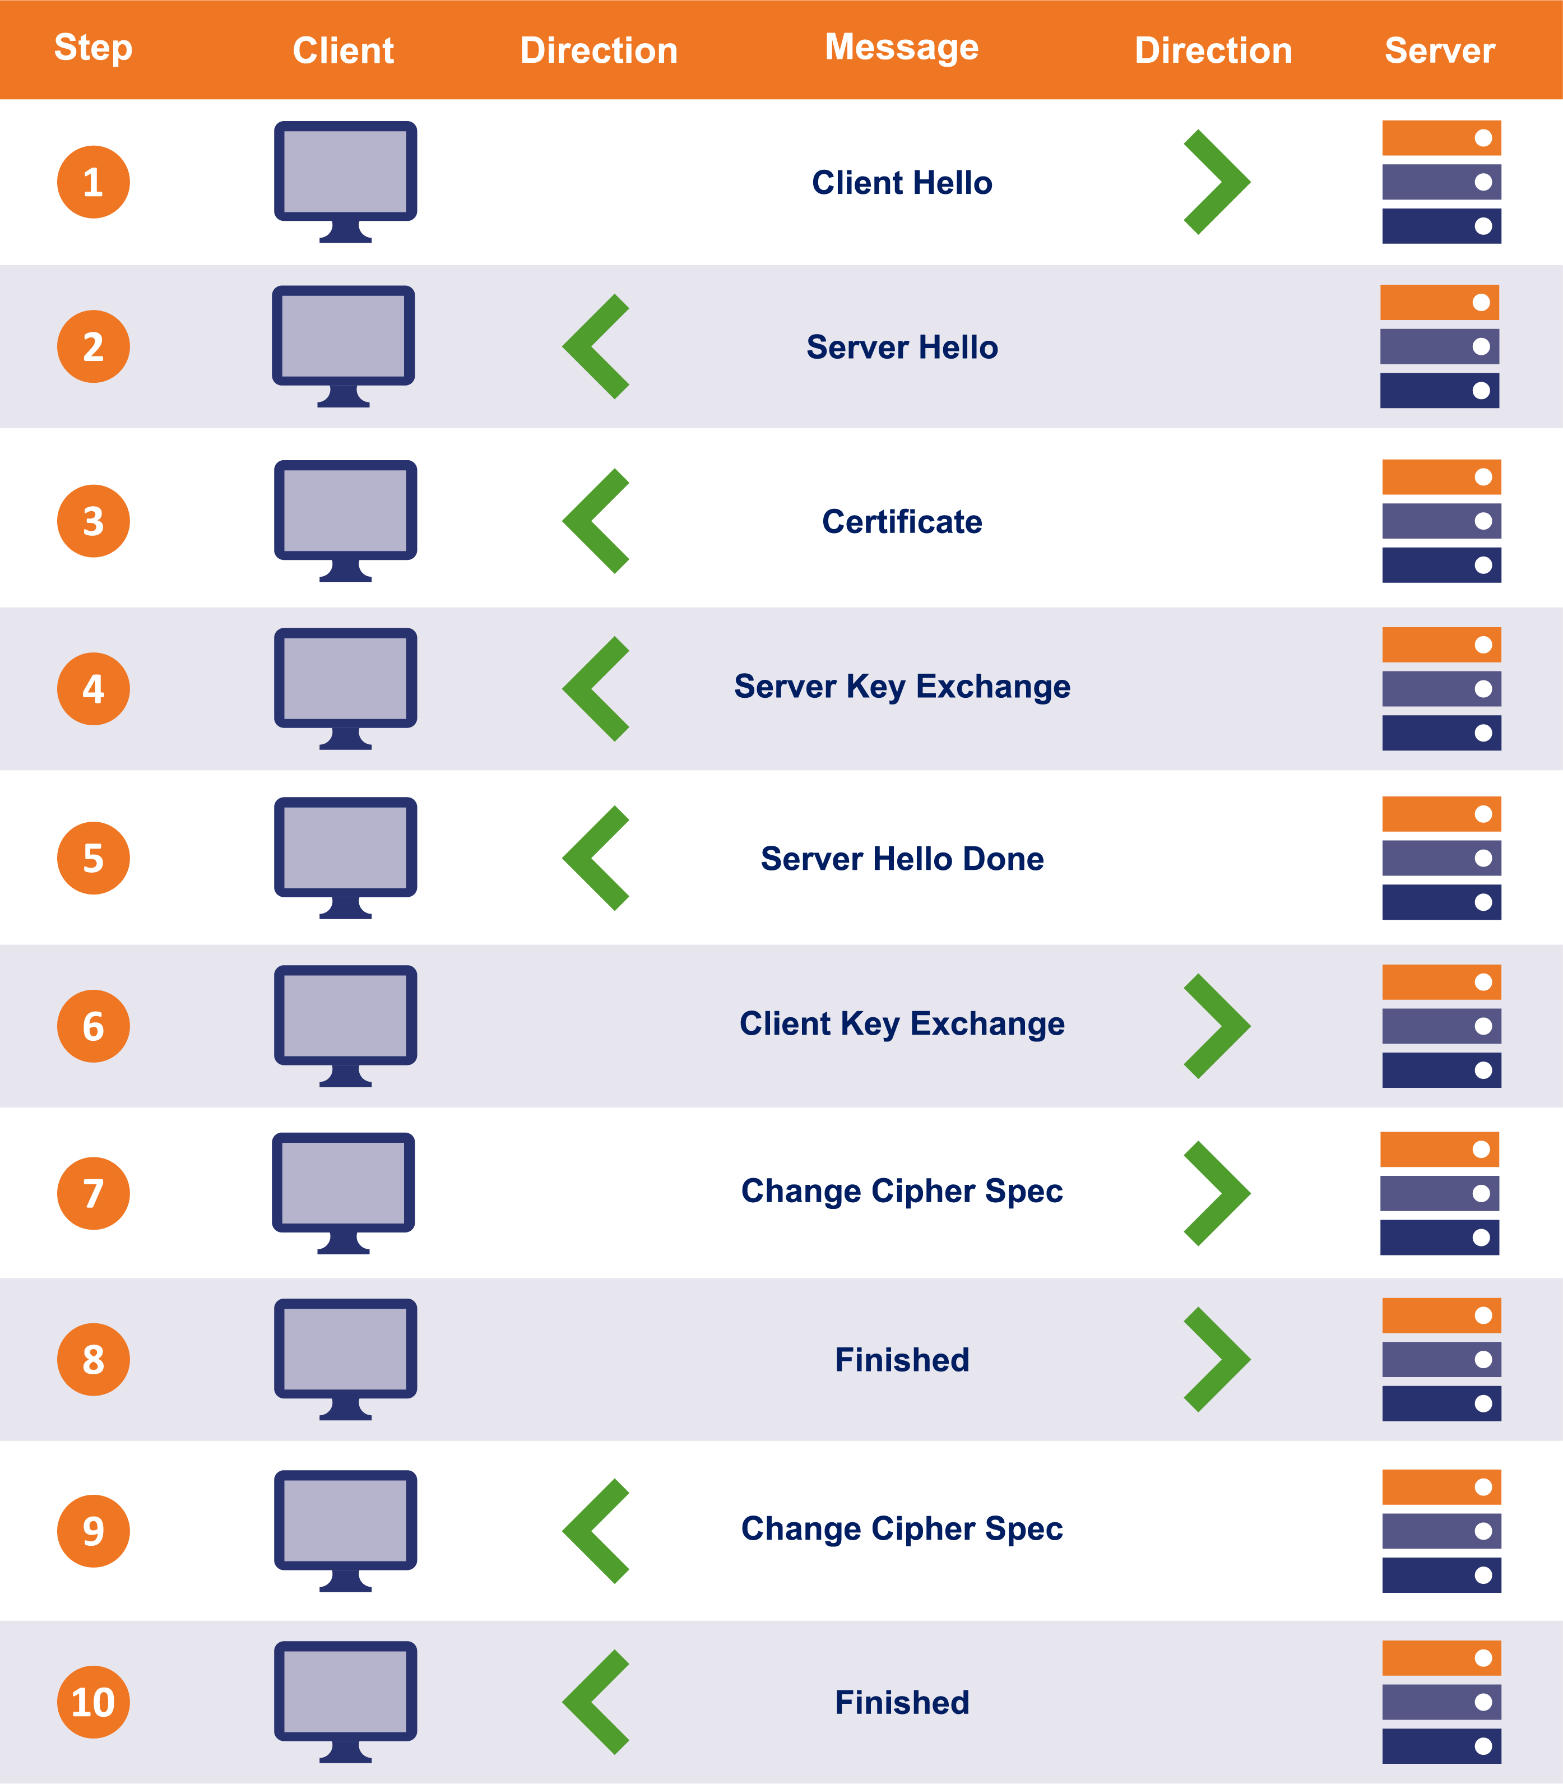
TLS 1.2 Handshake Review

Slide 6
End-to-End Handshake Visualization #2
Client Hellio
WEB BROWSER
Server Hello, Cert, KeyShare, HelloDone
WEB SERVER
KeyShare, Change Cipher Spec, {DONE}
Change Cipher Spec, {DONE}

Slide 7
Authentication
Client Hellio
WEB BROWSER
Server Hello, CERT, KeyShare, HelloDone
WEB SERVER
KeyShare, Change Cipher Spec, {DONE}
Change Cipher Spec, {DONE}
The “Certificate” message includes ONE OR MORE certificates.

Slide 8
Certificate Verification
CERTIFICATE
-----------------------------
Subject CN: amazon.com
Not Valid Before: 2001
Not Valid After: 2030
Issued By: amazon CA
Signature Blob: <sig>
WEB BROWSER
Verify “amazon.com” is the URL
Verify the validity period
(Other Verification)
Who issued the cert?

Slide 9
Certificate Chains
Subject CN: amazon CA
…
Issued By: GlobalSign
Signature Blob: <sig>
The certificate for the Host may be signed by an INTERMEDIATE Certificate Authority
Because the web browser probably doesn’t have this intermediate cert, the TLS handshake includes both certificates.
Subject CN: amazon.com
…
Issued By: amazon CA
Signature Blob: <sig>

Slide 10
Root CA Certificates
Certificate chains MUST have a ROOT
A Root Certificate is SELF SIGNED
Browsers trust a set of root certificates AXIOMATICALLY
Certificate chains must have a trust chain to one of these roots.

Slide 11
Trusting Diffie Hellman
Recall that DH keys are EPHEMERAL
The Server’s cert includes a long-term public key
The Server’s DH key is signed by this key pair
IF the client trusts the cert, THEN it can validate the DH key

Slide 12
TLS Bulk Transport
Both Client and Server derive keys
Encryption keys AND MAC keys
MAC’s ensure continuous authentication

Slide 13
When a TLS message is Received:
The sender is “proved” by the MAC
The MAC is “proved” via MAC key derived from DH
Server’s DH key “proved” authentic by cert signature
Certificate “proved” authentic by chain to trusted root

Slide 14
It All Depends on the Cert
IF a browser trusts MY certificate to be Amazon’s certificate
THEN the browser will trust my DH public key
IF the browser trusts my DH public key
THEN the browser will derive the same MAC key I do
IF the browser derives the same MAC key I do
THEN the browser will believe my messages are from Amazon

Slide 15
TLS Visibility
Typically, a browser/client MUST have a new root CA installed
This root CA is a self-signed certificate from the Visibility appliance
The appliance can now generate ANY cert and the browser believes it!
We will discuss the huge security concerns in a later lecture

Slide 16
TLS Visibility Handshake Visualization
Client Hellio
Client Hellio
Server Hello, FAKE CERT, KeyShare, HelloDone
TLS Visibility
Server Hello, Cert, KeyShare, HelloDone
WEB SERVER
WEB BROWSER
KeyShare, Change Cipher Spec, {DONE}
KeyShare, Change Cipher Spec, {DONE}
Change Cipher Spec, {DONE}
Change Cipher Spec, {DONE}

Slide 17
Your Lab:
Client Hellio
Client Hellio
Server Hello, FAKE CERT, KeyShare, HelloDone
TLS Visibility
Server Hello, Cert, KeyShare, HelloDone
WEB SERVER
WGET
KeyShare, Change Cipher Spec, {DONE}
KeyShare, Change Cipher Spec, {DONE}
Change Cipher Spec, {DONE}
Change Cipher Spec, {DONE}
You will have to read the client messages, but the only TLS packets you have to create are for the MITM
You do NOT write the TLS connection to the web server.

